Slide 1
Support vector machines
Machine Learning – Lab 2

Slide 2
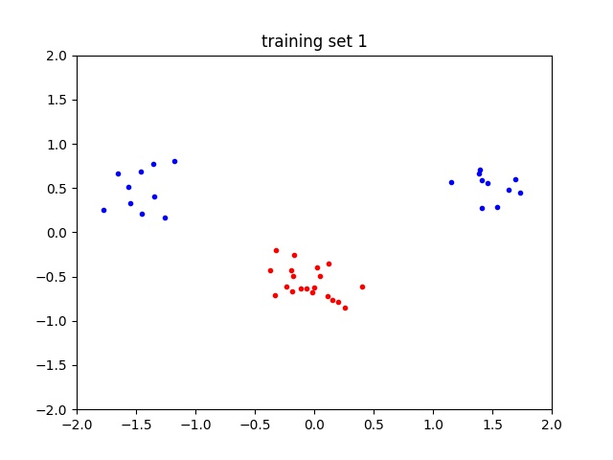
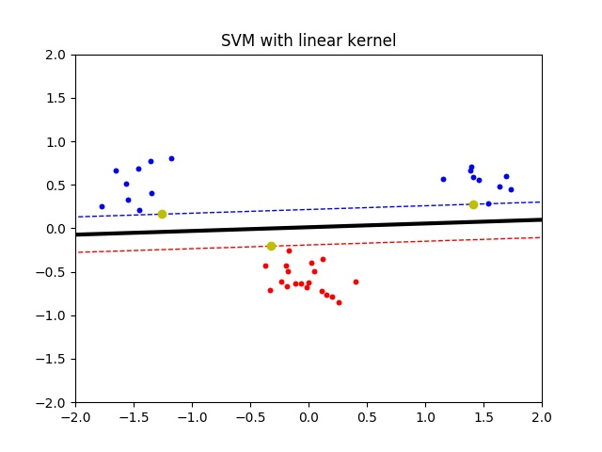
Linear kernel (I)

Slide 3
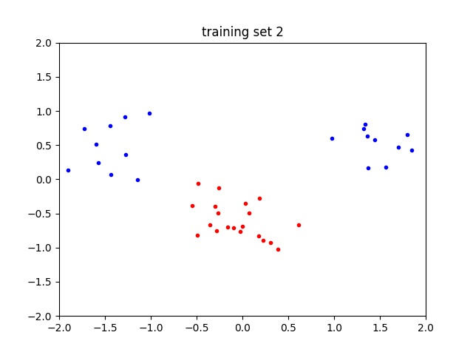
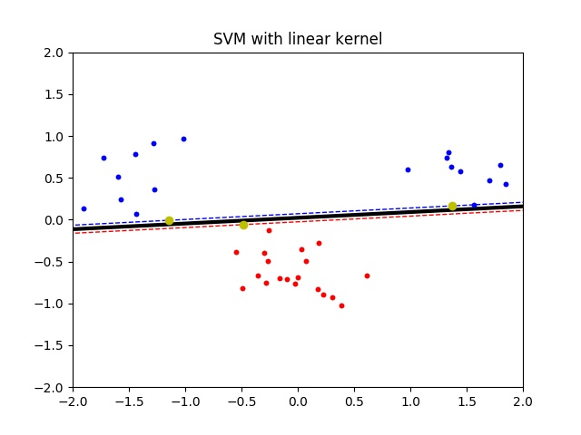
Linear kernel (II)

Slide 4
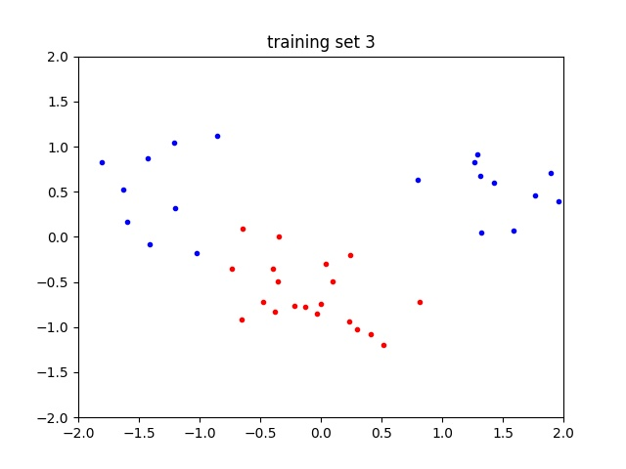
Linear kernel (III)
There is no separating hyperplane (line in this case, 2D).
No solution found by the optimizer.
How to solve?
Non-linear kernels
Slack variables

Slide 5
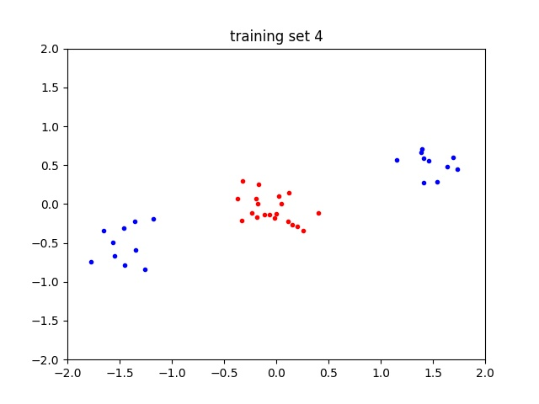
Linear kernel (IV)
There is no separating hyperplane (line in this case, 2D).
No solution found by the optimizer.
Linear kernel is clearly not useful even with slack variables.
How to solve?
Non-linear kernels

Slide 6
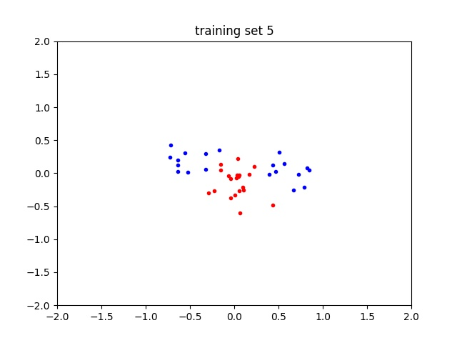
Difficult clusters
Rearranging clusters moving means to
Class A (1): [0.5, 0.2]
Class A (2): [-0.5, 0.2]
Class B : [0.0, -0.2]
Not linearly separable → linear kernel does not find a solution
We need a non-linear model

Slide 7
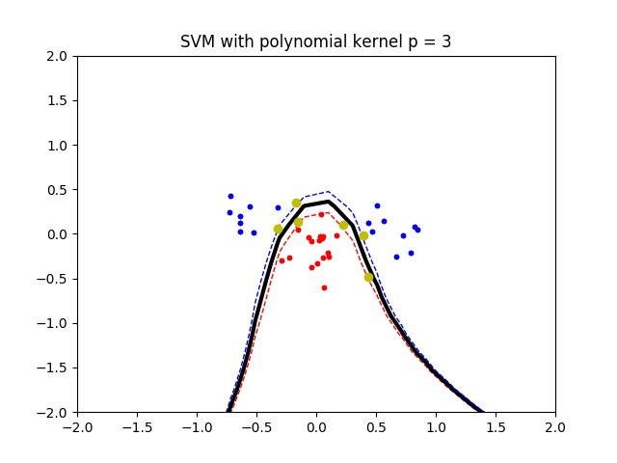
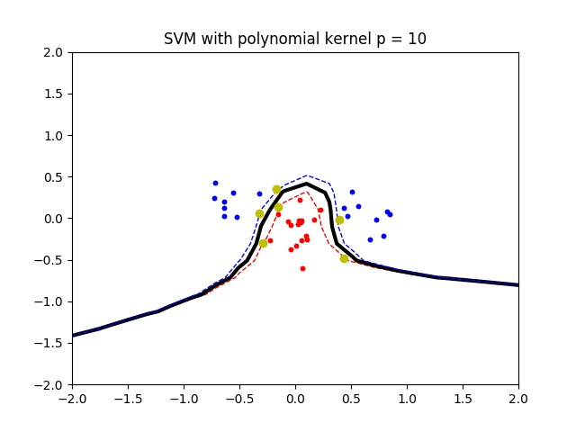
Polynomial kernel
Polynomial kernel manages to find a solution
The higher the degree, the better the decision boundary fits training data
Bias-variance trade-off: increasing the degree lowers bias but increases variance

Slide 8
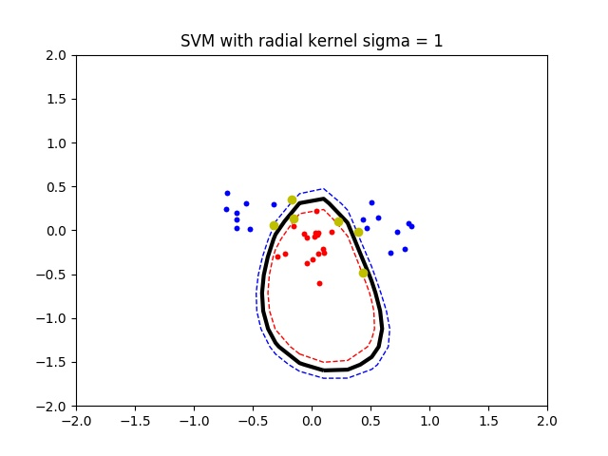
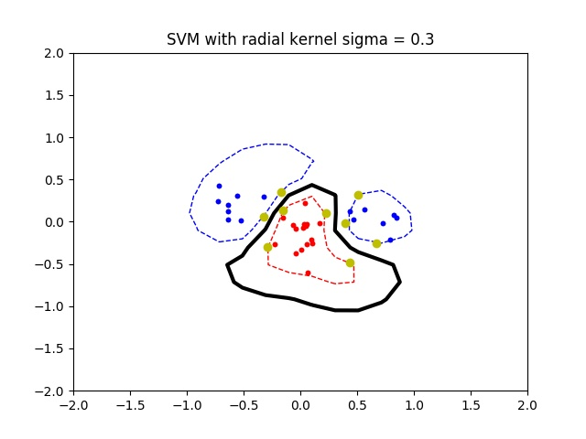
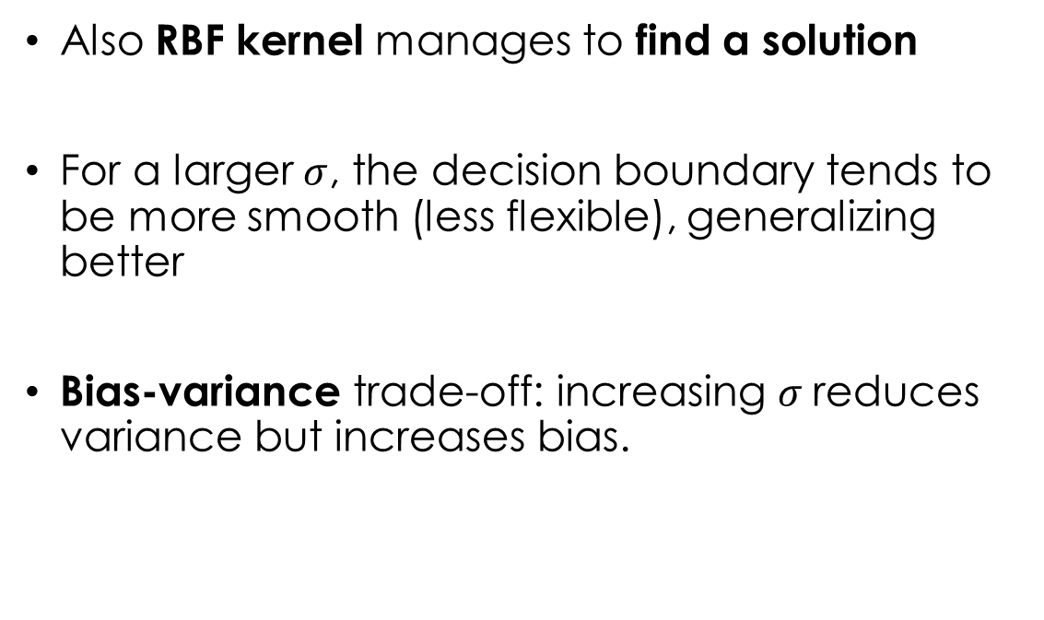
RBF kernel
Also RBF kernel manages to find a solution
For a larger $σ$, the decision boundary tends to be more smooth (less flexible), generalizing better
Bias-variance trade-off: increasing $σ$reduces variance but increases bias.

Slide 9
Slack variables
Slack variables allow to have soft margins
Some points can be on the wrong side of the margin or even of the decision boundary (misclassification)
Slack parameter C:
small values tolerate many points violating the margin
extreme case: infinity → no tolerance
Advantages: robust to noise (→ generalize better)

Slide 10
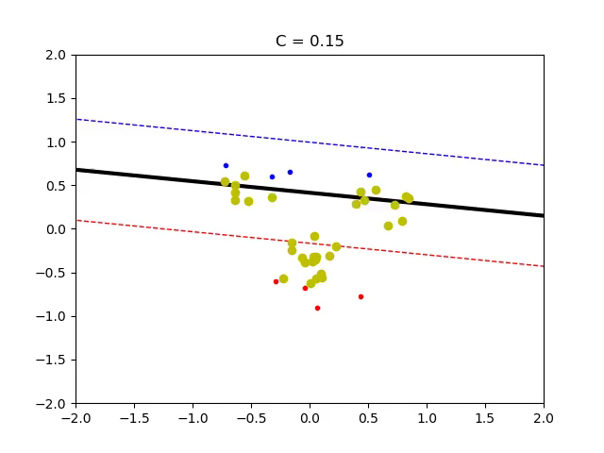
Slack parameter C - Linear
Qui puoi aggiungere quello nella slide linear kernel (II)?
I clusters sono:
*0.3 + [1.5, 0.5]
*0.3 + [-1.5, 0.5]
*0.3 + [0.0, -0.5]

Slide 11
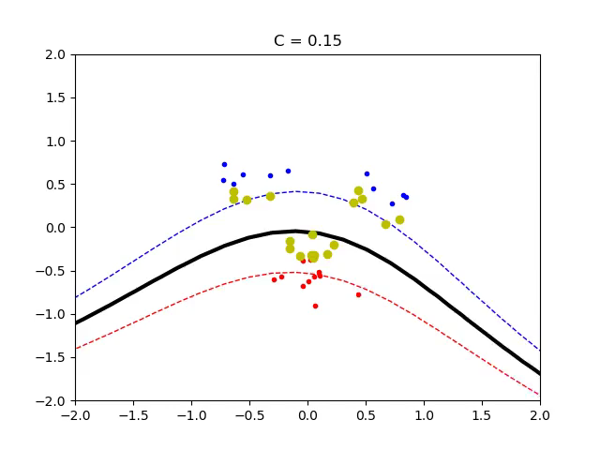
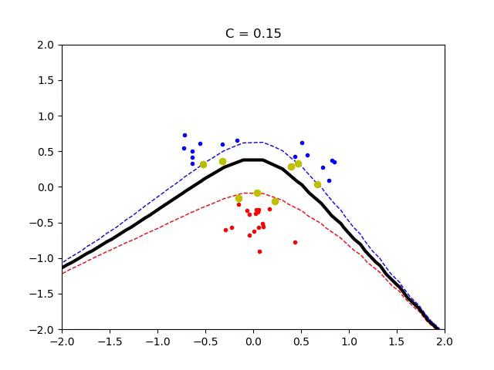
Slack parameter C - polynomial
Degree = 3
Degree = 9

Slide 12
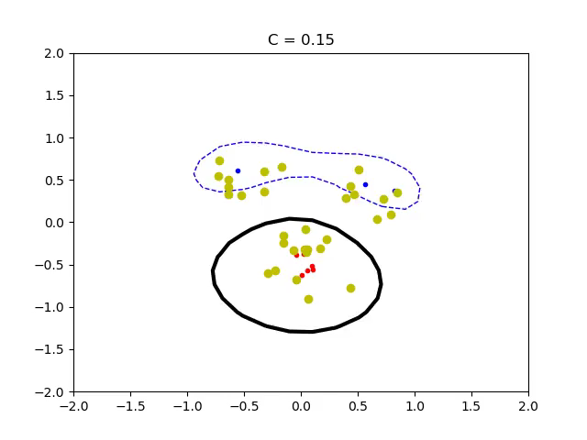
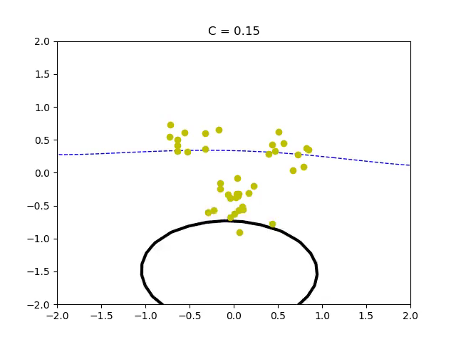
Slack parameter C - RBF
σ = 0.5
σ = 1.5

Slide 13
Slack vs complexity
More slack: when there is a lot of noise in the data. It means that using bigger slack we could get rid of outliers in the dataset and we don’t overfit noise in the final model
More complex: If we know that data are not noisy, but it is still difficult to get a nice classification, we should increase complexity of the model

